Slide 1
Employee Attrition Analysis
File created on: 8/13/2024 8:36:15 AM

Slide 2
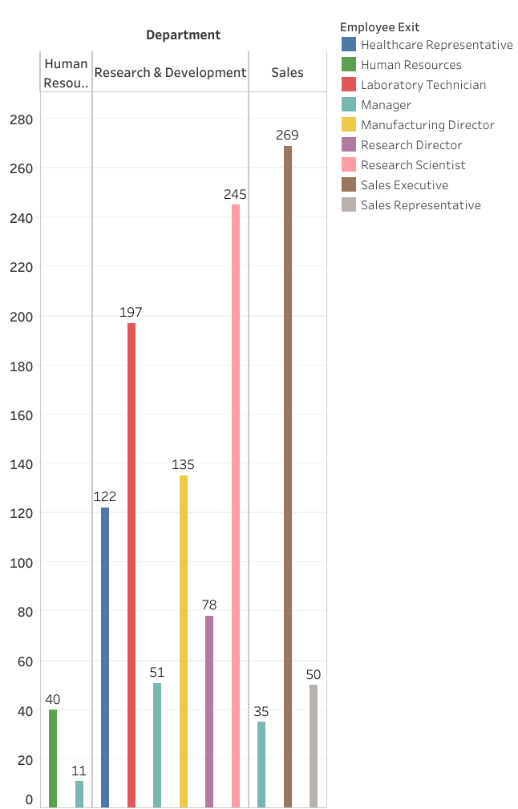

Slide 3
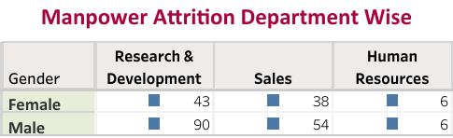

Slide 4
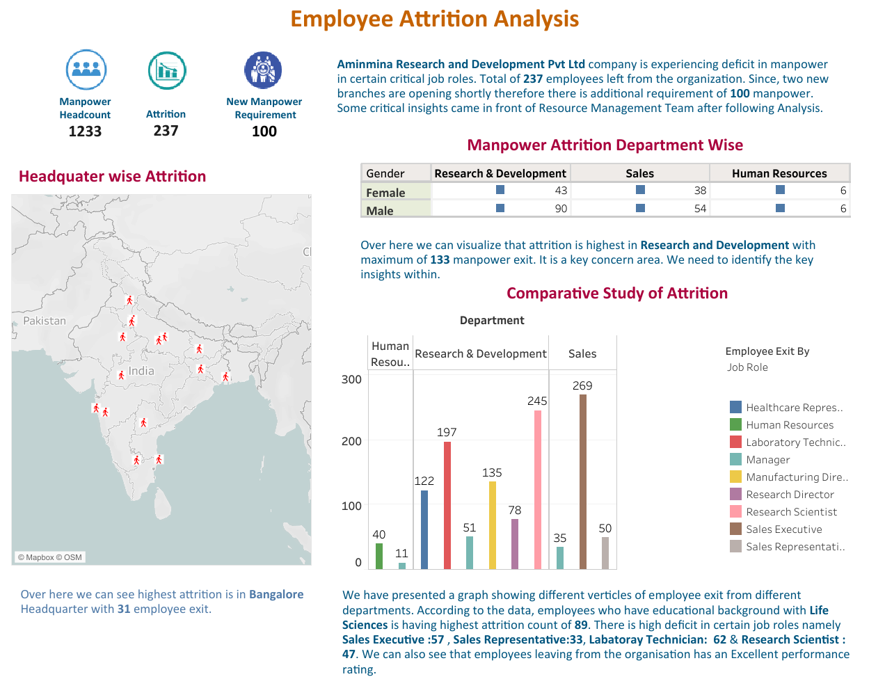

Slide 5
